Slide 1
Chapter 10
Chemical Bonding II

Slide 2
Chemical Bonds
There are two broad types are discussed so far:
Ionic bonding
Covalent bonding

Slide 3
Chemical Bonds
Depending on the electron sharing extent (Molecular Polarity or Bond polarity) Covalent bonds can also be divided into two broad types:
Polar covalent bonds
Non-polar covalent bonds

Slide 4
Molecular Polarity
Entirely depend on the “electronegativity of the elements” in bond formation and the resulting molecular geometry or symmetry

Slide 5
Molecular Polarity
One important result of molecular shape is molecular polarity
Molecular polarity is important because...
Polar molecules are water soluble
Nonpolar molecules are fat soluble
Water and fat are insoluble in each other

Slide 6
Solubility
Ionic
Polar covalent
Nonpolar covalent
Water soluble
Fat soluble

Slide 7
Electronegativities
Values increase across a row
2.1
(page 99)
1.0
1.5
2.0
2.5
3.0
3.5
4.0
0.9
1.2
1.5
1.8
2.1
2.5
3.0
0.8
1.0
1.3
1.5
1.6
1.6
1.5
1.8
1.8
1.8
1.9
1.6
1.6
1.8
2.0
2.4
2.8
0.8
1.0
1.2
1.4
1.6
1.8
1.9
2.2
2.2
2.2
1.9
1.7
1.7
1.8
1.9
2.1
2.5
1.3
1.5
1.7
1.9
2.2
2.2
2.2
2.4
1.9
Values increase up a column
0.7
0.9
1.1
1.8
1.8
1.9
2.0
2.2
Overall trend

Slide 8
Bond Types
Δe.n. Bond type
0.4 or less nonpolar covalent
0.5 - 1.9 polar covalent
2.0 or more ionic

Slide 9
Chlorine
Cl
Cl
Cl
A nonpolar covalent bond forms

Slide 10
Hydrogen Fluoride
H
F
A polar covalent bond

Slide 11

Hydrogen Fluoride
H
F
H
F
A polar covalent bond
http://academic.reed.edu/chemistry/roco/

Slide 12
A Polarity Continuum
Ionic
Polar covalent
Nonpolar covalent
2.0 1.9
0.5 0.4
0.0 Cl-Cl
1.9 H-F
0.9 H-Cl
0.0 C-C
2.1 Na-Cl
1.0 C-O
0.4 C-H
3.3 Cs-F
1.5 C-F
Metal + nonmetal
Carbon/Hydrogen + high e.n. atom
Hydrocarbons or two of same atom

Slide 13
Polarity
Can be applied to either individual bonds
or overall molecules
Polar molecules usually have polar bonds
Be alert for FON Cl (“phone call”) molecules to be polar
The elements in FON Cl are the most electronegative elements
They lead to polar bonds when hooked to other elements

Slide 14
The FONCl Atoms
2.1
1.0
1.5
2.0
2.5
3.0
3.5
4.0
0.9
1.2
1.5
1.8
2.1
2.5
3.0
0.8
1.0
1.3
1.5
1.6
1.6
1.5
1.8
1.8
1.8
1.9
1.6
1.6
1.8
2.0
2.4
2.8
0.8
1.0
1.2
1.4
1.6
1.8
1.9
2.2
2.2
2.2
1.9
1.7
1.7
1.8
1.9
2.1
2.5
0.7
0.9
1.1
1.3
1.5
1.7
1.9
2.2
2.2
2.2
2.4
1.9
1.8
1.8
1.9
2.0
2.2

Slide 15
Polarity
Nonpolar molecules usually have nonpolar bonds
Compounds made of only C and H atoms are ALWAYS nonpolar
Exceptions occur both ways...
Polar bonds may cancel out through symmetry
Lone pairs or π-electrons can impart some polarity to a molecule with only nonpolar bonds

Slide 16
Water Polarity
O
en 3.5
H
H
en 2.1
A bent molecule

Slide 17
Water Polarity
Overall molecular dipole
O
H
H

Slide 18
Water Polarity
Overall molecular dipole
O
H
H

Slide 19

Water Polarity
Overall molecular dipole
H
O
O
H
H
H
http://academic.reed.edu/chemistry/roco/

Slide 20
Methane Polarity
H
C
H
H
They cancel and yield a molecule with no overall dipole -- it’s nonpolar.
H

Slide 21
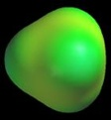
Methane Polarity
H
H
H
C
H
C
H
H
H
H
http://academic.reed.edu/chemistry/roco/

Slide 22
Carbon Dioxide Polarity
O
C
O

Slide 23
Carbon Dioxide Polarity
Δen = 3.5 - 2.5 = 1.0
Polar bonds
O
C
O

Slide 24
Carbon Dioxide Polarity
O
C
O

Slide 25
Carbon Dioxide Polarity
Equal but opposite polar bonds present
O
C
O

Slide 26
Carbon Dioxide Polarity
No overall molecular dipole established. It’s nonpolar.
O
C
O

Slide 27
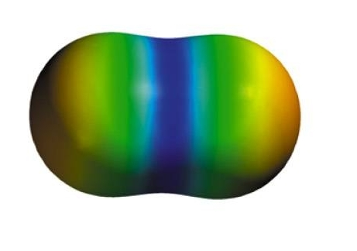
Carbon Dioxide Polarity
O
C
O
http://wps.prenhall.com/wps/media/objects/724/741576/Instructor_Resources/Chapter_01/Text_Images/FG01_18-21UN.JPG

Slide 28
Is CCl₄ polar?
Yes
No
Cl
C
Cl
Cl
Cl

Slide 29
Is CCl₄ polar?
Yes
No
Cl
C
Cl
Cl
Cl

Slide 30
Carbon Tetrachloride Polarity
Cl
C
Cl
Cl
Cl

Slide 31
Carbon Tetrachloride Polarity
Cl
Δen = 3.0 - 2.5 = 0.5
Polar bonds
C
Cl
Cl
Cl

Slide 32
Carbon Tetrachloride Polarity
Cl
C
Cl
Cl
Cl

Slide 33
Carbon Tetrachloride Polarity
Cl
C
Cl
Cl
Cl

Slide 34
Carbon Tetrachloride Polarity
Cl
C
Cl
Cl
Cl

Slide 35
Carbon Tetrachloride Polarity
Symmetric arrangement of bond dipoles cancel.
Molecule is nonpolar
Cl
C
Cl
Cl
Cl

Slide 36
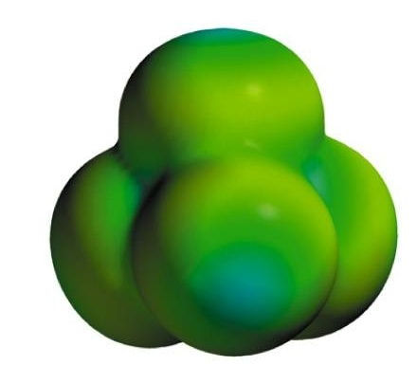
Carbon Tetrachloride Polarity
http://wps.prenhall.com/wps/media/objects/724/741576/Instructor_Resources/Chapter_01/Text_Images/FG01_18-21UN.JPG

Slide 37
Is NH₃ polar?
Yes
No
N
H
H
H

Slide 38
Is NH₃ polar?
Yes
No
N
H
H
H

Slide 39
Ammonia Polarity
N
H
H
H

Slide 40
Ammonia Polarity
Δen = 3.0 - 2.1 = 0.9
Polar bonds
N
H
H
H

Slide 41
Ammonia Polarity
N
H
H
H

Slide 42
Ammonia Polarity
N
H
H
H

Slide 43
Ammonia Polarity
N
H
H
H

Slide 44
Ammonia Polarity
Overall molecular dipole.
N
H
H
H

Slide 45
Ammonia Polarity
Overall molecular dipole.
It’s a polar molecule.
N
H
H
H

Slide 46
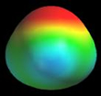
Ammonia Polarity
Overall molecular dipole.
It’s a polar molecule.
N
H
H
H
http://academic.reed.edu/chemistry/roco/

Slide 47
Is lithium hydride polar?
Yes
No
Li
H

Slide 48
Is lithium hydride polar?
Yes
No
Li
H

Slide 49
Is lithium hydride polar?
Li
H

Slide 50
Is lithium hydride polar?
Δen = 2.1 – 1.0 = 1.1
Polar bond
Li
H

Slide 51
Is lithium hydride polar?
Δen = 2.1 – 1.0 = 1.1
Polar bond
Li
H

Slide 52

Is lithium hydride polar?
http://academic.reed.edu/chemistry/roco/

Slide 53
Shapes of Bigger Molecules
How do you describe molecular geometry when more than one central atom is present?
You describe the geometry around each central atom

Slide 54
Acetaldehyde
H
O
H
C
C
H
H

Slide 55
Acetaldehyde
H
O
H
C
C
H
H
There are two central atoms here

Slide 56
Acetaldehyde
H
O
H
C
C
H
1
H
There are two central atoms here

Slide 57
Acetaldehyde
H
O
H
C
C
H
1
2
H
There are two central atoms here

Slide 58
Acetaldehyde
H
O
H
C
C
H
1
2
H
There are two central atoms here

Slide 59
Acetaldehyde
H
O
H
C
C
H
1
2
C₁ shows four regions with 4 bonds
H

Slide 60
Acetaldehyde
H
O
H
C
C
H
1
2
C₁ shows four regions with 4 bonds -- it’s tetrahedral
H

Slide 61
Acetaldehyde
H
O
H
C
C
H
1
2
H
C₂ shows three regions with 3 bonds

Slide 62
Acetaldehyde
H
O
H
C
C
H
1
2
H
C₂ shows three regions with 3 bonds -- it’s a triangular plane

Slide 63
Acetaldehyde
H
O
H
C
C
H
1
2
So it’s a tetrahedron hooked to a triangular plane
H

Slide 64
Acetaldehyde
H
H
C
O
H
C
H

Slide 65
Acetaldehyde
H
H
The tetrahedral part
C
O
H
C
H

Slide 66
Acetaldehyde
H
H
The triangular plane part
C
O
H
C
H

Slide 67
Acetaldehyde
H
H
C
O
H
C
H

Slide 68
Acetaldehyde
Molecular polarity?
H
H
C
O
H
C
H

Slide 69
Acetaldehyde
Molecular polarity?
H
H
C
O
H
C
H

Slide 70
Acetaldehyde
Molecular polarity?
H
H
C
O
H
C
Nonpolar hydrocarbon portion
H

Slide 71
Acetaldehyde
Molecular polarity?
H
H
C
O
H
C
Polar bond!
Nonpolar hydrocarbon portion
H

Slide 72
Acetaldehyde
Molecular polarity?
H
H
C
O
H
C
Polar bond!
Nonpolar hydrocarbon portion
H

Slide 73
Ethyl Alcohol Polarity
H
H
H
C
C
O
H
H
H

Slide 74
Ethyl Alcohol Polarity
H
H
H
C
C
O
H
H
H
High en atom!

Slide 75
Ethyl Alcohol Polarity
H
H
H
C
C
O
H
H
H
High en atom! Not symmetric molecule!

Slide 76
Ethyl Alcohol Polarity
H
H
H
C
C
O
H
H
H
High en atom! Not symmetric molecule! It’s polar!

Slide 77
Ethyl Alcohol Polarity
tetrahedral
tetrahedral
bent
H
H
H
C
C
O
H
H
H
High en atom! Not symmetric molecule! It’s polar!

Slide 78
Ethyl Alcohol Polarity
H
H
C
O
H
C
H
H
H

Slide 79
Ethyl Alcohol Polarity
H
H
C
O
H
C
H
H
H
Polar bonds

Slide 80
Ethyl Alcohol Polarity
Molecular polarity
H
H
C
O
H
C
H
H
H
Polar bonds

Slide 81
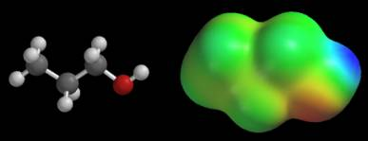
CH₃CH₂CH₂OH
Propanol, a polar alcohol
http://academic.reed.edu/chemistry/roco/Potential/standard_color_scale.html

Slide 82
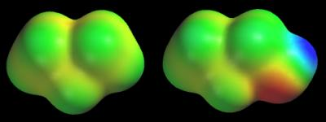
H
H
H
H
C
C
H
C
C
C
H
C
H
H
O
H
H
CH₃CH₂CH₃
CH₃CH₂CH₂OH
Propane, a nonpolar hydrocarbon
Propanol, a polar alcohol
http://academic.reed.edu/chemistry/roco/Potential/standard_color_scale.html

Slide 83
The Shapes of Molecules
The shape of a 2-atom compound is always linear.
With 3 or more atoms, the geometries (bond angles) are determined by analyzing...
- How many regions of electron density ……central atoms have, and
- How many of those regions are occupied ……in bonds

Slide 84
Molecular Geometry
Valence shell:
It is the outermost electron occupied shell of an atom, it holds the electrons that are usually involved in bonding.
Valence-Shell Electron-Pair Repulsion (VSEPR) model:
Predict the geometry of the molecule from the electrostatic repulsions between the electron (bonding and nonbonding) pairs.

Slide 85

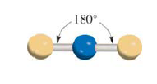
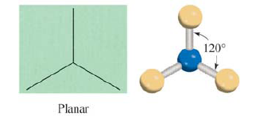
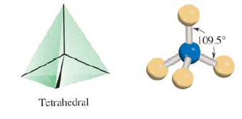
Molecules in which the central atom has no lone pairs Beryllium Chloride
Boron Trifluoride Methane

Slide 86
Hybridization- mixing of two or more atomic orbitals to form a new set of hybrid orbitals
Mix at least 2 nonequivalent atomic orbitals (e.g. s and p.). Hybrid orbitals have very different shape from original atomic orbitals.
Number of hybrid orbitals is equal to number of pure atomic orbitals used in the hybridization process.
Covalent bonds are formed by
Overlap of hybrid orbitals with atomic orbitals.
Overlap of hybrid orbitals with other hybrid orbitals.

Slide 87
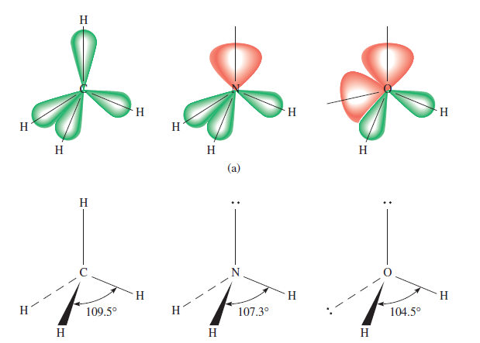
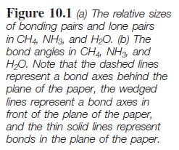

Slide 88
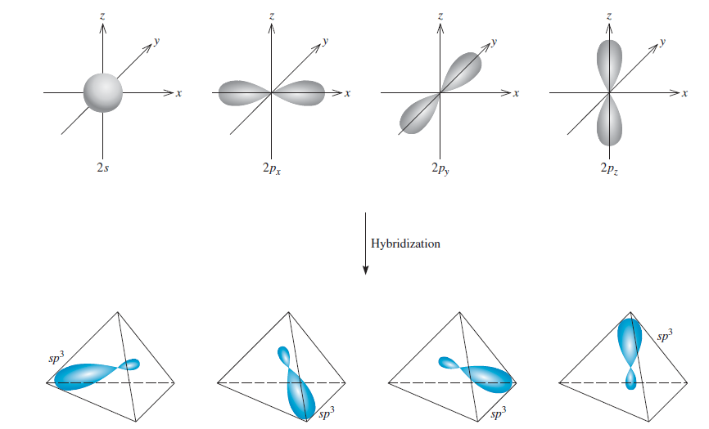
Formation of sp³ Hybrid Orbitals

Slide 89
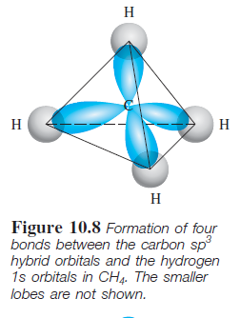
Formation of Covalent bonds in CH₄

Slide 90
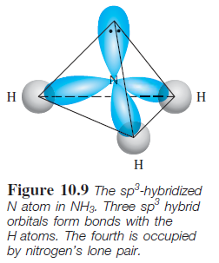
sp³ Hybridizes N atom in NH₃

Slide 91
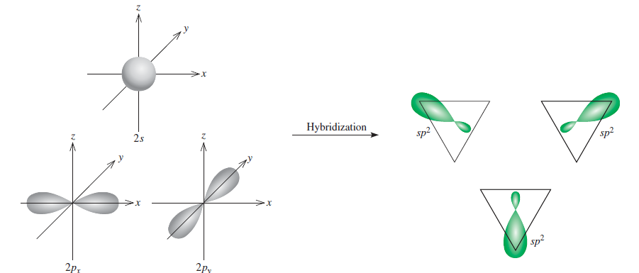
Formation of sp² Hybrid Orbitals

Slide 92
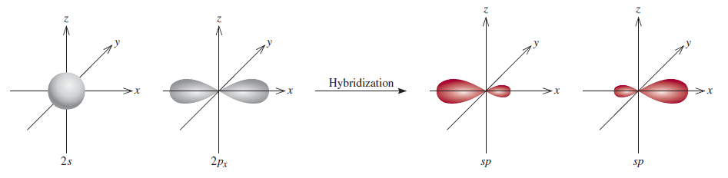
Formation of sp Hybrid Orbitals

Slide 93
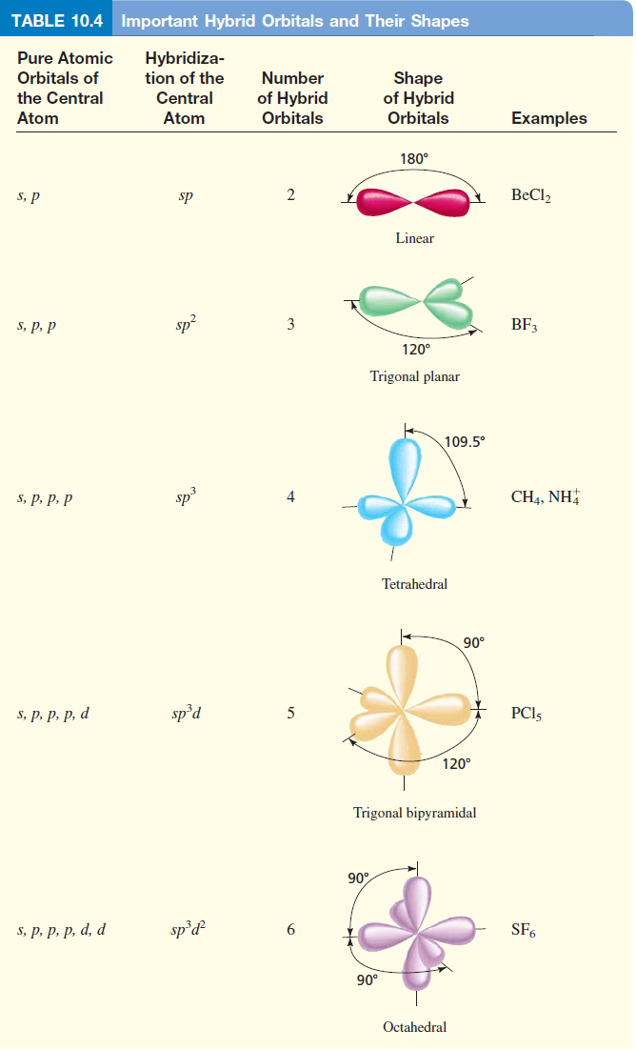

Slide 94
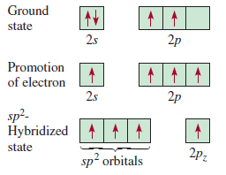
sp² hybridization of carbon

Slide 95
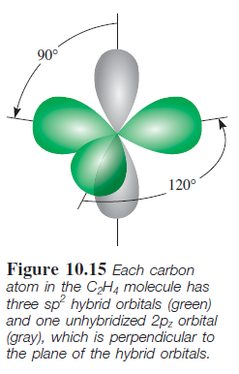

Slide 96
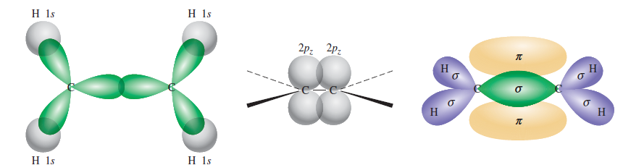
Bonding of ethylene, C₂H₄
Sigma bond (σ): electron density between 2 atoms.
Pi bond (π): electron density above and below plane of nuclei of the bonding atoms.

Slide 97
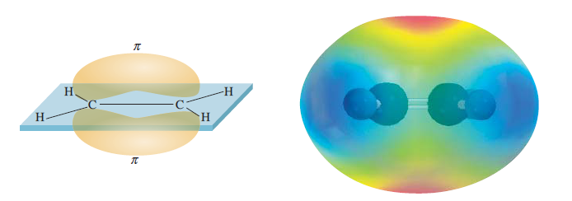
Another view of π bonding in ethylene, C₂H₄

Slide 98
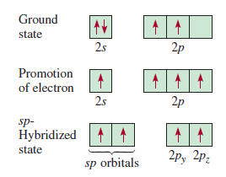
sp hybridization of carbon

Slide 99
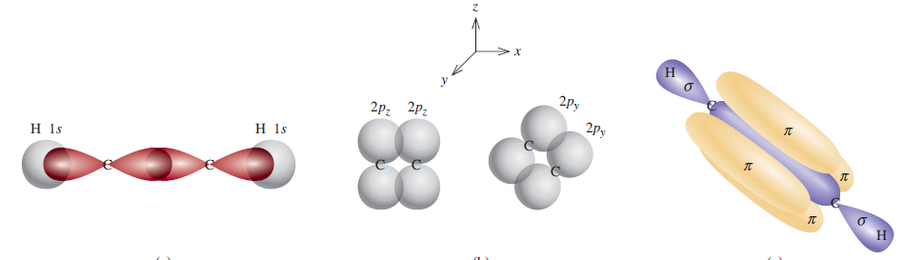
Bonding of Acetylene, C₂H₂

Slide 100
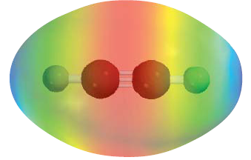
Another view of the Bonding of Acetylene, C₂H₂

Slide 101
Sigma (σ) and Pi Bonds (π)
Single bond 1 sigma bond
Double bond 1 sigma bond and 1 Pi bond
Triple bond 1 sigma bond and 2 Pi bonds
How many sigma and Pi bonds are there in the acetic acid (Vinegar) molecule CH₃COOH?

Slide 102
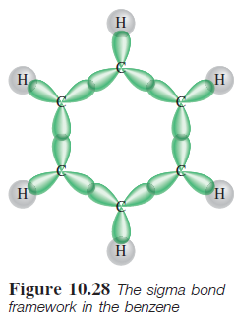
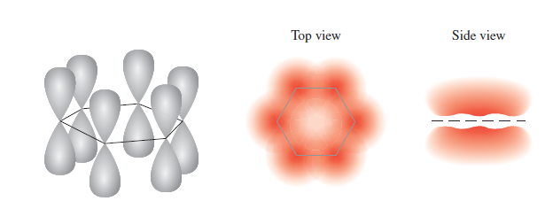
Delocalized molecular orbitals are not confined between two adjacent bonding atoms, but actually extend over three or more atoms.
Delocalized πorbital

Slide 103
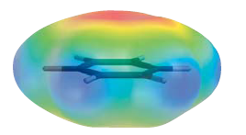
Electron density above and below the plane of the benzene molecule

Slide 104
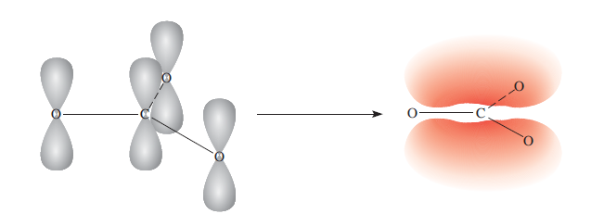
Bonding in the Carbonate ion CO₃²⁻

Slide 105
The VSEPR Model
Geometries can be predicted from the Valence Shell Electron Pair Repulsion model (VSEPR)
It places regions of electron density as far apart as possible

Slide 106
3 Steps to VSEPR Shape
1. Draw a Lewis structure
2. Count regions of e⁻ density around.central atom
Triple bond = 1 region
Double bond = 1 region
Single bond = 1 region
Lone pair = 1 region
3. Count the number of regions with bonds ….around atom

Slide 107
# of regions # with bonds Shape
2 2 Linear
3 2 Bent
3 Trigonal planar
4 2 Bent
3 Triangular pyramid
4 Tetrahedral

Slide 108
# of regions # with bonds Shape
5 2 Linear
3 T-shaped
4 See Saw
5 Triangular bipyramid
6 2 Linear
3 T-shaped
4 Square planar
5 Square pyramid
6 Octahedral

Slide 109
General Rules for Lewis Structures
Most organic and biochemical molecules follow the orderly bonding patterns we’ve been practicing
Many inorganic molecules do not follow these bonding patterns
Here’s a general procedure that ALWAYS works…

Slide 110
General Rules for Lewis Structures
1. Find total # of valence e-’s in molecule or ion
2. Connect the skeleton with single bonds
3. Place lone pairs to give non-H terminal atoms an octet
Check to see how many e⁻’s are left and if all octets
(duets) are satisfied
If e⁻’s still left, go to 4
If e⁻’s are short, go to 5
If e⁻’s just right, you’re done
4. Place remaining e⁻’s on central atom (but check)
5. If short e-’s, look for multiple bonders or e⁻ deficients

Slide 111
Example 1: Laughing Gas
N
N
O
How many regions of electron density?

Slide 112
Example 1: Laughing Gas
Atom of interest
N
N
O
How many regions of electron density?

Slide 113
Example 1: Laughing Gas
1
N
N
O
How many regions of electron density?

Slide 114
Example 1: Laughing Gas
1
2
N
N
O
How many regions of electron density?

Slide 115
Example 1: Laughing Gas
Ignore! Not around central atom of interest!
1
2
N
N
O
So we have 2 regions

Slide 116
Example 1: Laughing Gas
1
2
N
N
O
So we have 2 regions

Slide 117
Example 1: Laughing Gas
1
2
N
N
O
How many regions are bonds?

Slide 118
Example 1: Laughing Gas
1
2
N
N
O
1
How many regions are bonds?

Slide 119
Example 1: Laughing Gas
1
2
N
N
O
1
2
How many regions are bonds?

Slide 120
Example 1: Laughing Gas
1
2
N
N
O
1
2
So we have 2 regions with 2 bonds

Slide 121
# of regions # with bonds Shape
2 2 Linear
3 2 Bent
3 Trigonal planar
4 2 Bent
3 Triangular pyramid
4 Tetrahedral

Slide 122
# of regions # with bonds Shape
2 2 Linear
3 2 Bent
3 Trigonal planar
4 2 Bent
3 Triangular pyramid
4 Tetrahedral

Slide 123
# of regions # with bonds Shape
2 2 Linear
3 2 Bent
3 Trigonal planar
4 2 Bent
3 Triangular pyramid
4 Tetrahedral

Slide 124
# of regions # with bonds Shape
2 2 Linear
3 2 Bent
3 Trigonal planar
4 2 Bent
3 Triangular pyramid
4 Tetrahedral

Slide 125
Example 2: Carbonate Ion
1. Find total # of valence e-’s in molecule or ion
1 x C = 1 x 4e⁻ = 4 e⁻
3 x O = 3 x 6e⁻ = 18 e⁻
species charge = 2 e⁻
______________________________
Total 24 e⁻

Slide 126
Example 2: Carbonate Ion
2. Connect the skeleton with single bonds
O
O
C
O
24 e⁻

Slide 127
Example 2: Carbonate Ion
2. Connect the skeleton with single bonds
3. Place lone pairs to give non-H terminal atoms an octet
O
O
C
O
24 e⁻

Slide 128
Example 2: Carbonate Ion
2. Connect the skeleton with single bonds
3a. Check to see how many e⁻’s are left and all octets
O
O
C
O
24 e⁻’s used, octet NOT okay
24 e⁻

Slide 129
Example 2: Carbonate Ion
2. Connect the skeleton with single bonds
3a. Check to see how many e⁻’s are left and all octets
O
O
C
O
Uh-oh! We’re short e⁻’s!
24 e⁻

Slide 130
Example 2: Carbonate Ion
If short e⁻’s, go to 5
O
O
C
O
Uh-oh! We’re short e⁻’s!
24 e⁻

Slide 131
Example 2: Carbonate Ion
5. If short e-’s, look for multiple bonders or e⁻ deficients
O
O
C
O
Uh-oh! We’re short e⁻’s!
24 e⁻

Slide 132
Example 2: Carbonate Ion
5. If short e-’s, look for multiple bonders or e⁻ deficients
O
O
C
O
We’re short 2 e⁻’s, so need 1 multiple bond
24 e⁻

Slide 133
Example 2: Carbonate Ion
5. If short e-’s, look for multiple bonders or e⁻ deficients
O
O
C
O
Move a lone pair into a shared position
24 e⁻

Slide 134
Example 2: Carbonate Ion
5. If short e-’s, look for multiple bonders or e⁻ deficients
O
O
C
O
Octet full, 24 e⁻’s preserved
24 e⁻

Slide 135
Example 2: Carbonate Ion
O
O
C
O
We’re almost done...
24 e⁻

Slide 136
Example 2: Carbonate Ion
2-
O
O
C
O
24 e⁻

Slide 137
Example 2: Carbonate Ion
2-
O
O
C
O
Now for its shape
24 e⁻

Slide 138
How many regions of density in CO₃²⁻?
2
3
4
5
6

Slide 139
How many regions of density in CO₃²⁻?
2
3
4
5
6

Slide 140
Example 2: Carbonate Ion
2-
O
O
C
O
Regions
24 e⁻

Slide 141
Example 2: Carbonate Ion
2-
O
O
1
C
O
1Region
24 e⁻

Slide 142
Example 2: Carbonate Ion
2-
O
2
O
1
C
O
2 Regions
24 e⁻

Slide 143
Example 2: Carbonate Ion
2-
O
2
O
1
C
3
O
3 Regions
24 e⁻

Slide 144
Example 2: Carbonate Ion
2-
O
2
O
1
C
3
O
3 Regions Bonds
24 e⁻

Slide 145
Example 2: Carbonate Ion
2-
O
2
O
1
C
3
O
1
3 Regions 1 Bond
24 e⁻

Slide 146
Example 2: Carbonate Ion
2-
O
2
2
O
1
C
3
O
1
3 Regions 2 Bonds
24 e⁻

Slide 147
Example 2: Carbonate Ion
2-
O
2
2
O
1
C
3
O
3
1
3 Regions 3 Bonds
24 e⁻

Slide 148
# of regions # with bonds Shape
2 2 Linear
3 2 Bent
3 Trigonal planar
4 2 Bent
3 Triangular pyramid
4 Tetrahedral

Slide 149
# of regions # with bonds Shape
2 2 Linear
3 2 Bent
3 Trigonal planar
4 2 Bent
3 Triangular pyramid
4 Tetrahedral

Slide 150
# of regions # with bonds Shape
2 2 Linear
3 2 Bent
3 Trigonal planar
4 2 Bent
3 Triangular pyramid
4 Tetrahedral

Slide 151
# of regions # with bonds Shape
2 2 Linear
3 2 Bent
3 Trigonal planar
4 2 Bent
3 Triangular pyramid
4 Tetrahedral

Slide 152
Example 2: Carbonate Ion
2-
O
C
O
O
Better drawing!

Slide 153
Example 2: Carbonate Ion
2-
O
120º
120º
C
O
O
120º
Better drawing!

Slide 154
Example 2: Carbonate Ion
2-
O
C
O
O
Why did I put the double bond to the lower left?

Slide 155
Example 2: Carbonate Ion
2-
O
C
O
O
Electron pairs can be “pushed” to new positions

Slide 156
Example 2: Carbonate Ion
2-
O
C
O
O
It could just as easily be on top

Slide 157
Example 2: Carbonate Ion
2-
O
C
O
O
Elecron pairs can be “pushed” to new positions

Slide 158
Example 2: Carbonate Ion
2-
O
C
O
O
Or to the right

Slide 159
Resonance structures
O
C
-
-
O
O
-
O
-
O
C
-
C
O
O
-
O
O

Slide 160
Resonance structures
O
C
-
-
O
O
-
The real structure is a hybrid of all three
O
-
O
C
-
C
O
O
-
O
O

Slide 161
Example 2: Carbonate Ion
2-
O
C
O
O
Best drawing?

Slide 162
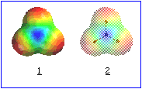
Here’s how we now view each lobe of the π-orbital

Slide 163
Example 2: Carbonate Ion
O
σ
C
O
σ
O
σ
Three σ-orbitals form a triangular plane (seen from slightly above here)

Slide 164
Example 2: Carbonate Ion
O
σ
π⁺
C
O
σ
O
σ
One lobe of the π molecular orbital forms a triangular half-bun on top of the molecule

Slide 165
Example 2: Carbonate Ion
O
π⁺
C
O
O
π⁻
The second lobe of the π molecular orbital forms a triangular half-bun on the bottom of the molecule

Slide 166
Example 2: Carbonate Ion
O
π⁺
C
O
O
π⁻
Essentially, the two π-electrons are free to wander throughout the region of the triangular buns

Slide 167
Example 2: Carbonate Ion
O
π⁺
C
O
O
π⁻
This imparts a special stability to the structure

Slide 168
Laughing Gas Reconsidered
N
N
O
What’s this…

Slide 169
Laughing Gas Reconsidered
N
N
O
…compared to this?

Slide 170
Laughing Gas Reconsidered
N
N
O
Resonance structures!

Slide 171
Laughing Gas Reconsidered
N
N
O
There’s a third. Can you find it?

Slide 172
Laughing Gas Reconsidered
N
N
O
Here it is

Slide 173
Laughing Gas Reconsidered
N
N
O
It’s even less likely

Slide 174
Example 3: Water
How about water’s geometry?
We get off easy because we obtained its Lewis structure a couple of days ago...

Slide 175
How many valence electrons in H₂O?
18
12
8
4

Slide 176
How many valence electrons in H₂O?
18
12
8
4
1 x O = 1 x 6 e⁻ = 6 e⁻
2 x H = 2 x 1e⁻ = 2 e⁻
species charge = 0 e⁻
______________________________
Total 8 e⁻

Slide 177
Example 3: Water
H
O
H

Slide 178
How many regions of density in H₂O?
2
3
4
5
6

Slide 179
How many regions of density in H₂O?
2
3
4
5
6

Slide 180
Example 3: Water
H
O
H
Regions

Slide 181
Example 3: Water
H
1
O
H
1 Region

Slide 182
Example 3: Water
2
H
1
O
H
2 Regions

Slide 183
Example 3: Water
2
H
1
O
3
H
3 Regions

Slide 184
Example 3: Water
2
H
1
O
3
H
4
4 Regions

Slide 185
Example 3: Water
2
H
1
O
3
H
4
4 Regions Bonds

Slide 186
Example 3: Water
2
H
1
O
3
H
1
4
4 Regions 1 Bond

Slide 187
Example 3: Water
2
H
1
O
3
H
1
2
4
4 Regions 2 Bonds

Slide 188
# of regions # with bonds Shape
2 2 Linear
3 2 Bent
3 Trigonal planar
4 2 Bent
3 Triangular pyramid
4 Tetrahedral

Slide 189
# of regions # with bonds Shape
2 2 Linear
3 2 Bent
3 Trigonal planar
4 2 Bent
3 Triangular pyramid
4 Tetrahedral

Slide 190
# of regions # with bonds Shape
2 2 Linear
3 2 Bent
3 Trigonal planar
4 2 Bent
3 Triangular pyramid
4 Tetrahedral

Slide 191
# of regions # with bonds Shape
2 2 Linear
3 2 Bent
3 Trigonal planar
4 2 Bent
3 Triangular pyramid
4 Tetrahedral

Slide 192
Example 3: Water
H
O
H

Slide 193
Example 3: Water
H
105º
O
H

Slide 194
# of regions # with bonds Shape
2 2 Linear
3 2 Bent
3 Trigonal planar
4 2 Bent
3 Triangular pyramid
4 Tetrahedral

Slide 195
Example 4: Ammonia
N

Slide 196
# of regions # with bonds Shape
2 2 Linear
3 2 Bent
3 Trigonal planar
4 2 Bent
3 Triangular pyramid
4 Tetrahedral

Slide 197
# of regions # with bonds Shape
2 2 Linear
3 2 Bent
3 Trigonal planar
4 2 Bent
3 Triangular pyramid
4 Tetrahedral

Slide 198
Example 4: Ammonia
H
N
H
H

Slide 199
# of regions # with bonds Shape
2 2 Linear
3 2 Bent
3 Trigonal planar
4 2 Bent
3 Triangular pyramid
4 Tetrahedral

Slide 200
# of regions # with bonds Shape
2 2 Linear
3 2 Bent
3 Trigonal planar
4 2 Bent
3 Triangular pyramid
4 Tetrahedral

Slide 201
# of regions # with bonds Shape
2 2 Linear
3 2 Bent
3 Trigonal planar
4 2 Bent
3 Triangular pyramid
4 Tetrahedral

Slide 202
Example 5: Ammonia
+
H
N
H
H
H

Slide 203
Expanded Octets
Elements in Group 5A (or higher) and in Period 3 (or bigger) can possess 10 e⁻’s in their outer shell

Slide 204
Expanded Octets
Elements in Group 5A (or higher) and in Period 3 (or bigger) can possess 10 e⁻’s in their outer shell
Cl
Cl
Phosphorus pentachloride
P
Cl
Cl
Cl

Slide 205
Expanded Octets
Elements in Group 5A (or higher) and in Period 3 (or bigger) can possess 10 e⁻’s in their outer shell
Cl
Cl
Lewis structure
P
Cl
Cl
Cl

Slide 206
Expanded Octets
Elements in Group 5A (or higher) and in Period 3 (or bigger) can possess 10 e⁻’s in their outer shell
Cl
Cl
10 electrons
P
Cl
Cl
Cl

Slide 207
Expanded Octets
Elements in Group 6A (or higher) and in Period 3 (or biggerer) can possess 12 e⁻’s in their outer shell

Slide 208
Expanded Octets
Elements in Group 6A (or higher) and in Period 3 (or bigger) can possess 12 e⁻’s in their outer shell
F
F
F
Sulfur hexafluoride
S
F
F
F

Slide 209
Expanded Octets
Elements in Group 6A (or higher) and in Period 3 (or bigger) can possess 12 e⁻’s in their outer shell
F
F
F
Lewis structure
S
F
F
F

Slide 210
Expanded Octets
Elements in Group 6A (or higher) and in Period 3 (or bigger) can possess 12 e⁻’s in their outer shell
F
F
F
S
12 electrons
F
F
F

Slide 211
Octet Exceptions

Slide 212
Electron Deficient Species
4e⁻
6e⁻

Slide 213
Could have 10 e⁻’s
8A
5A
6A
7A
10e⁻
10e⁻
10e⁻

Slide 214
Could have 12 e⁻’s
8A
5A
6A
7A
12e⁻
12e⁻
12e⁻

Slide 215
Example 7: Xenon Tetrafluoride
Let’s try analyzing the geometry of xenon tetrafluoride, XeF₄.
This is our first exposure to a compound containing a noble gas

Slide 216
How many valence electrons in XeF₄?
36
32
28
24

Slide 217
How many valence electrons in XeF₄?
36
32
28
24

Slide 218
Example 4: Xenon Tetrafluoride
1. Find total # of valence e-’s in molecule or ion
1 x Xe = 1 x 8e⁻ = 8 e⁻
4 x F = 4 x 7e⁻ = 28 e⁻
species charge = 0 e⁻
______________________________
Total 36 e⁻

Slide 219
Example 4: Xenon Tetrafluoride
2. Connect the skeleton with single bonds
36 e⁻

Slide 220
Example 4: Xenon Tetrafluoride
2. Connect the skeleton with single bonds
F
F
Xe
F
F
36 e⁻

Slide 221
Example 4: Xenon Tetrafluoride
3. Place lone pairs to give non-H terminal atoms an octet
F
F
Xe
F
F
36 e⁻

Slide 222
Example 4: Xenon Tetrafluoride
3. Place lone pairs to give non-H terminal atoms an octet
F
F
Xe
F
F
36 e⁻

Slide 223
Example 4: Xenon Tetrafluoride
3a. Check to see how many e⁻’s are left and all octets
F
F
Xe
F
F
36 e⁻

Slide 224
Example 4: Xenon Tetrafluoride
3a. Check to see how many e⁻’s are left and all octets
F
F
Xe
F
8 e⁻’s
left octet okay
F
36 e⁻

Slide 225
Example 4: Xenon Tetrafluoride
3a. Check to see how many e⁻’s are left and all octets
F
F
Xe
F
8 + 8 = 16 e⁻’s
bottom octet okay
F
36 e⁻

Slide 226
Example 4: Xenon Tetrafluoride
3a. Check to see how many e⁻’s are left and all octets
F
F
Xe
F
F
8 + 16 = 24 e⁻’s
right octet okay
36 e⁻

Slide 227
Example 4: Xenon Tetrafluoride
3a. Check to see how many e⁻’s are left and all octets
F
F
Xe
F
F
8 + 24 = 32 e⁻’s
top octet okay
36 e⁻

Slide 228
Example 4: Xenon Tetrafluoride
3a. Check to see how many e⁻’s are left and all octets
F
0 + 32 = 32 e⁻’s
middle octet okay
F
Xe
F
F
36 e⁻

Slide 229
Example 4: Xenon Tetrafluoride
3a. Check to see how many e⁻’s are left and all octets
F
0 + 32 = 32 e⁻’s
middle octet okay
but...
F
Xe
F
F
36 e⁻

Slide 230
Example 4: Xenon Tetrafluoride
3a. Check to see how many e⁻’s are left and all octets
F
0 + 32 = 32 e⁻’s
I haven’t used
all 36 e⁻’s!
F
Xe
F
F
36 e⁻

Slide 231
Example 4: Xenon Tetrafluoride
If e⁻’s still left, go to 4
F
0 + 32 = 32 e⁻’s
I haven’t used
all 36 e⁻’s!
F
Xe
F
F
36 e⁻

Slide 232
Example 4: Xenon Tetrafluoride
Place remaining e⁻’s on central atom (but check)
F
0 + 32 = 32 e⁻’s
I haven’t used
all 36 e⁻’s!
F
Xe
F
F
36 e⁻

Slide 233
Example 4: Xenon Tetrafluoride
Place remaining e⁻’s on central atom (but check)
F
4 + 32 = 36 e⁻’s
I’ve used
all 36 e⁻’s!
F
Xe
F
F
36 e⁻

Slide 234
Example 4: Xenon Tetrafluoride
Place remaining e⁻’s on central atom (but check)
F
It’s an expanded octet. Okay for Xe.
F
Xe
F
F
36 e⁻

Slide 235
Example 4: Xenon Tetrafluoride
F
F
Xe
F
F
36 e⁻

Slide 236
Example 4: Xenon Tetrafluoride
F
F
Xe
F
F
Now for its shape

Slide 237
How many regions of density in XeF₄?
2
3
4
5
6

Slide 238
How many regions of density in XeF₄?
2
3
4
5
6

Slide 239
Example 4: Xenon Tetrafluoride
F
F
Xe
F
F
Regions

Slide 240
Example 4: Xenon Tetrafluoride
F
F
Xe
F
1
F
1 Region

Slide 241
Example 4: Xenon Tetrafluoride
F
2
F
Xe
F
1
F
2 Regions

Slide 242
Example 4: Xenon Tetrafluoride
F
2
3
F
Xe
F
1
F
3 Regions

Slide 243
Example 4: Xenon Tetrafluoride
F
2
3
F
Xe
4
F
1
F
4 Regions

Slide 244
Example 4: Xenon Tetrafluoride
F
2
3
F
Xe
4
F
1
5
F
5 Regions

Slide 245
Example 4: Xenon Tetrafluoride
F
2
3
F
Xe
4
F
1
6
5
F
6 Regions

Slide 246
Example 4: Xenon Tetrafluoride
F
F
Xe
F
F
6 Regions

Slide 247
Example 4: Xenon Tetrafluoride
F
F
Xe
F
F
6 Regions
Bonds

Slide 248
Example 4: Xenon Tetrafluoride
F
F
Xe
F
1
F
6 Regions
1 Bond

Slide 249
Example 4: Xenon Tetrafluoride
F
F
Xe
F
2
1
F
6 Regions
2 Bonds

Slide 250
Example 4: Xenon Tetrafluoride
F
3
F
Xe
F
2
1
F
6 Regions
3 Bonds

Slide 251
Example 4: Xenon Tetrafluoride
F
3
F
Xe
4
F
2
1
F
6 Regions
4 Bonds

Slide 252
# of regions # with bonds Shape
5 2 Linear
3 T-shaped
4 See Saw
5 Triangular bipyramid
6 2 Linear
3 T-shaped
4 Square planar
5 Square pyramid
6 Octahedral

Slide 253
# of regions # with bonds Shape
5 2 Linear
3 T-shaped
4 See Saw
5 Triangular bipyramid
6 2 Linear
3 T-shaped
4 Square planar
5 Square pyramid
6 Octahedral

Slide 254
# of regions # with bonds Shape
5 2 Linear
3 T-shaped
4 See Saw
5 Triangular bipyramid
6 2 Linear
3 T-shaped
4 Square planar
5 Square pyramid
6 Octahedral

Slide 255
# of regions # with bonds Shape
5 2 Linear
3 T-shaped
4 See Saw
5 Triangular bipyramid
6 2 Linear
3 T-shaped
4 Square planar
5 Square pyramid
6 Octahedral

Slide 256
Example 4: Xenon Tetrafluoride
F
F
F
Xe
Xe
F
F

Slide 257


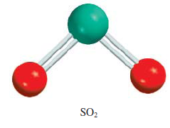


Molecules in which the central atom has one or more lone pairs
Sulfur Dioxide (SO₂) Ammonia (NH₃) Water (H₂O)

Slide 260
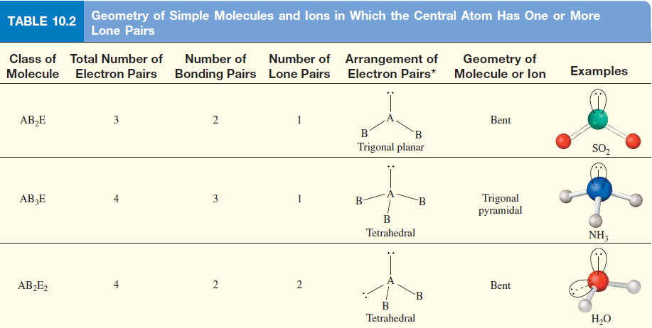
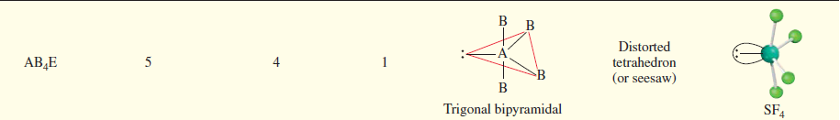

Slide 261
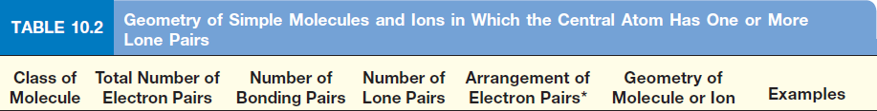
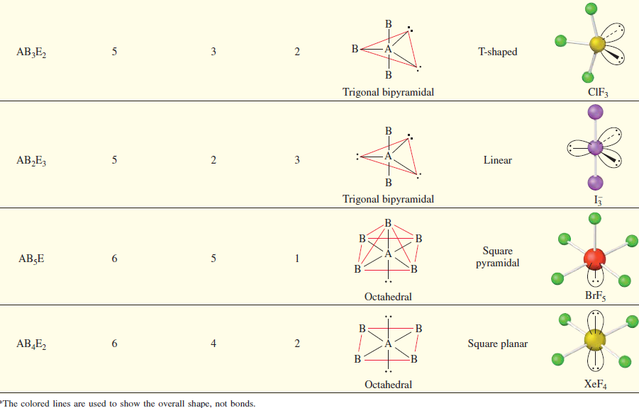

Slide 262
